Slide 1
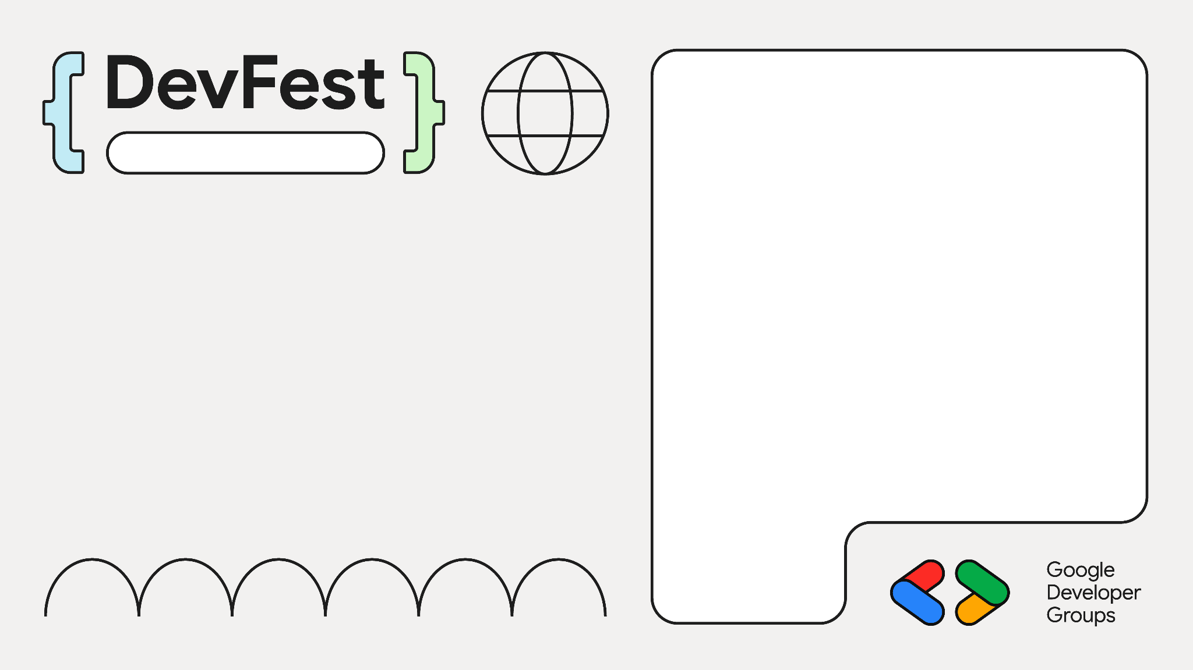

深入理解 Compose UI 布局
Beijing
王鹏 Android GDE
《Jetpack Compose 从入门到实战》作者

Slide 2
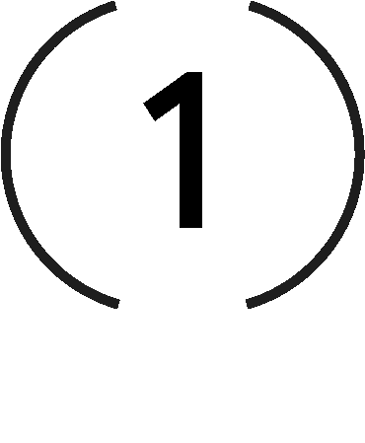
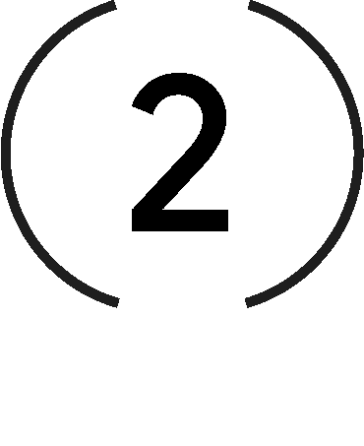
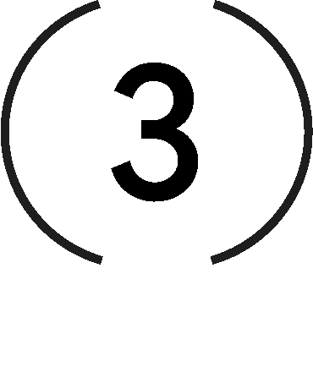

Contents
Compose phase
Layout phase
Modifiers
Intrinsic measurements

Slide 3
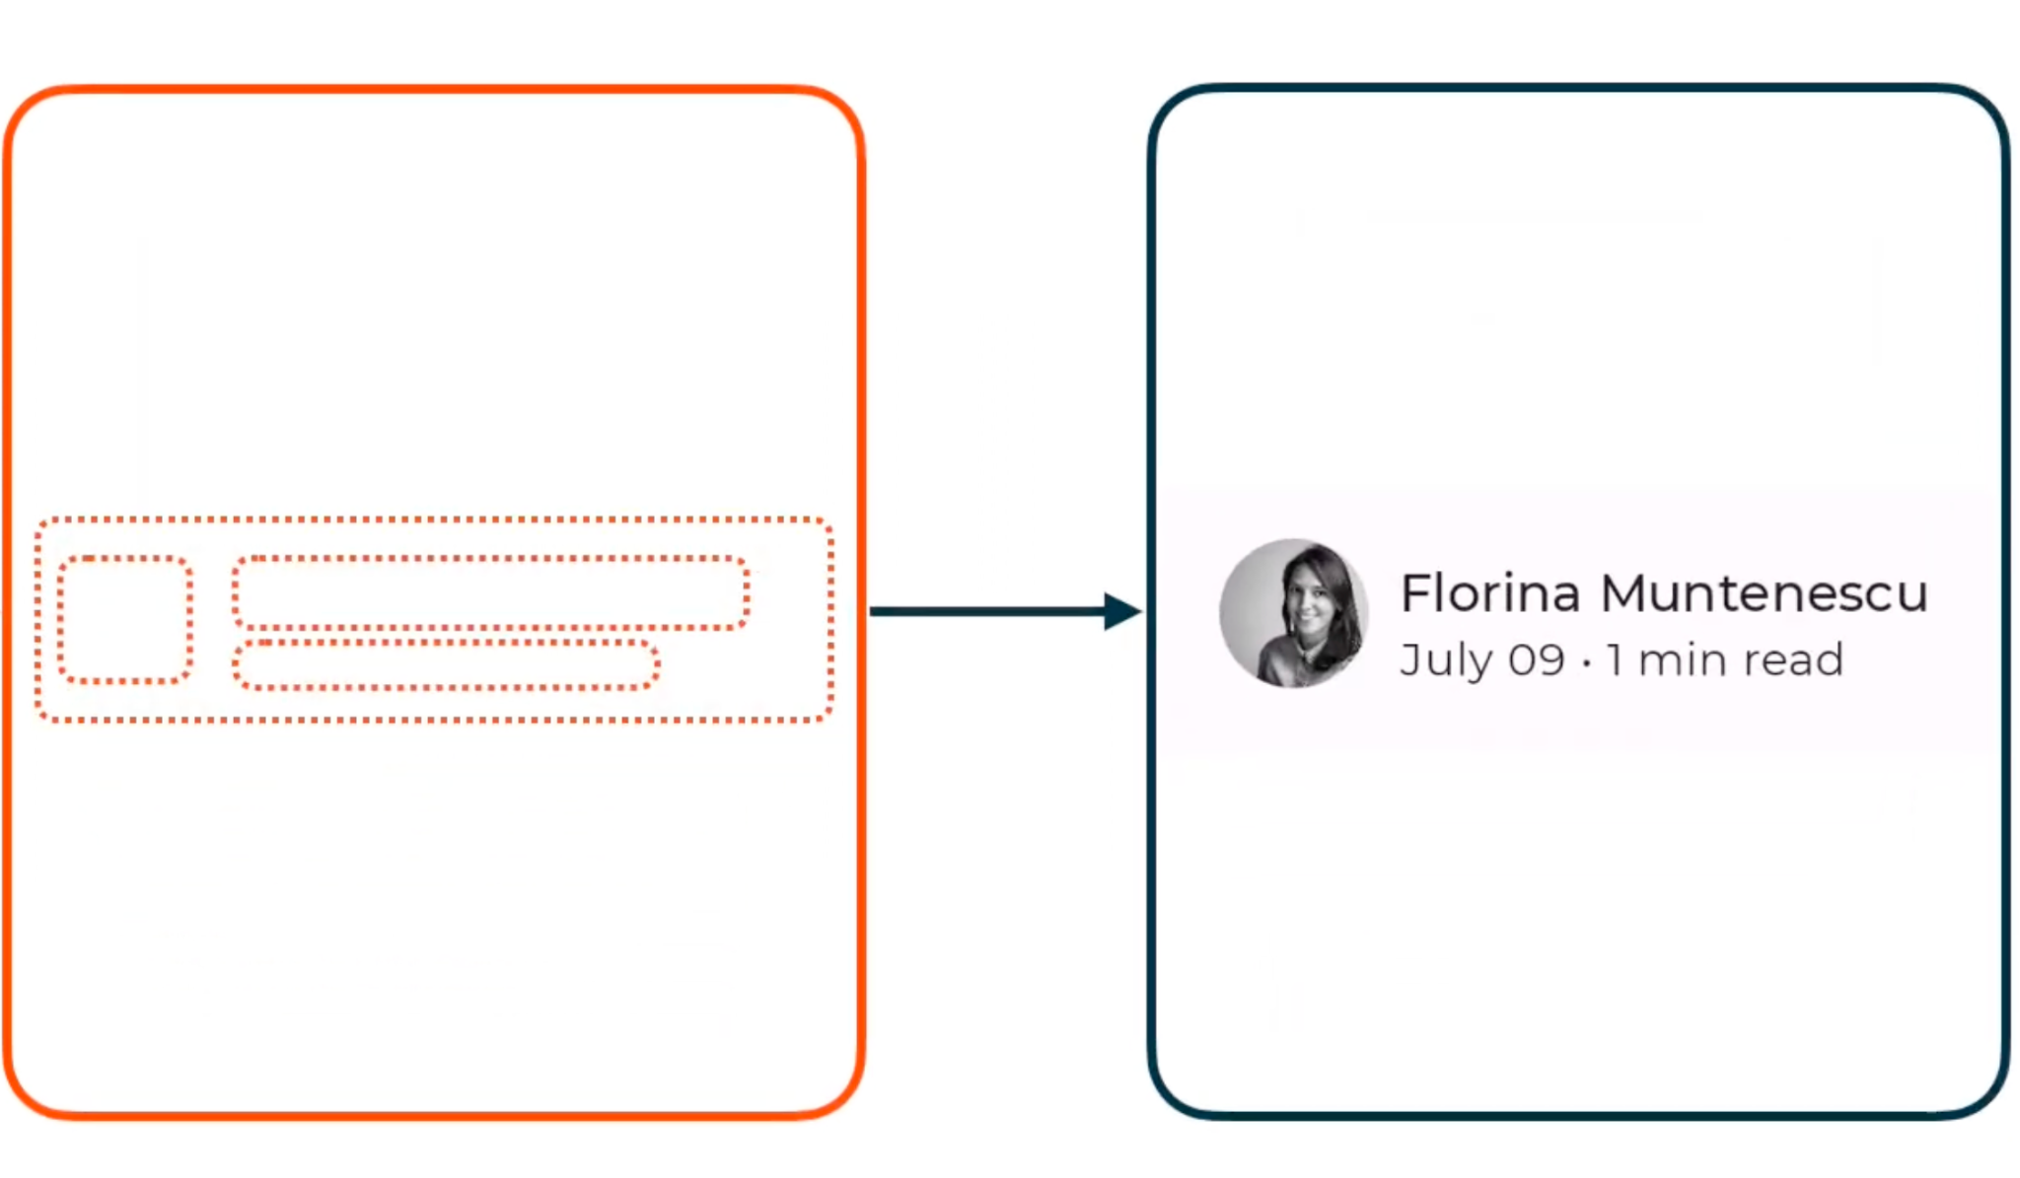
Jetpack Compose
@Composable
fun SearchResult(...) {
Row(...) {
Image(...)
Column(...) {
Text(...)
Text(...)
}
}
}

Slide 4
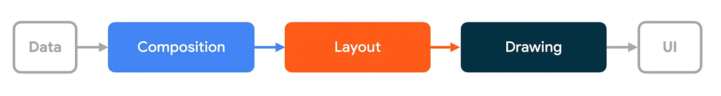
Compose phases
1. Composition: Compose runs composable functions and creates a layout node tree.
2. Layout: Measure and place the elements for each node in the layout tree.
3. Drawing: UI elements draw into a Canvas, usually a device screen.

Slide 5
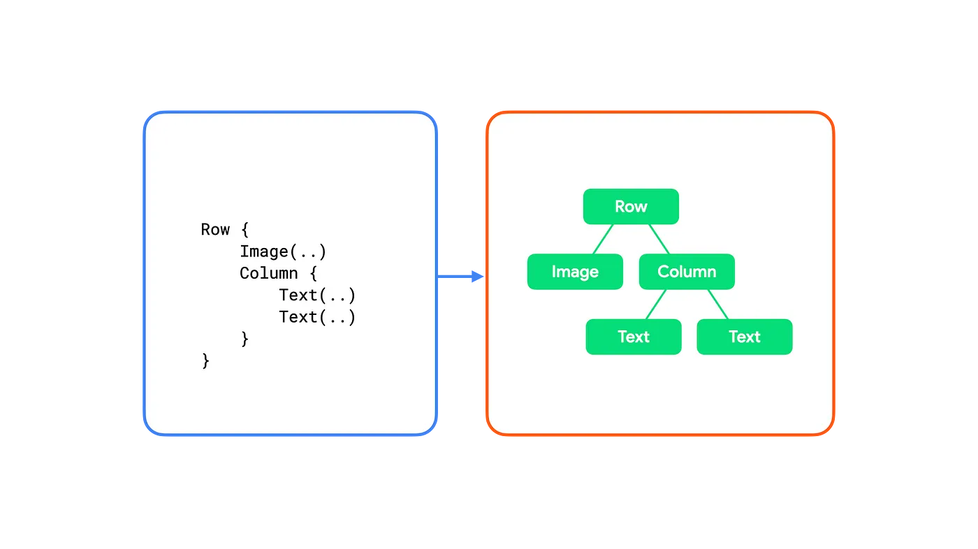
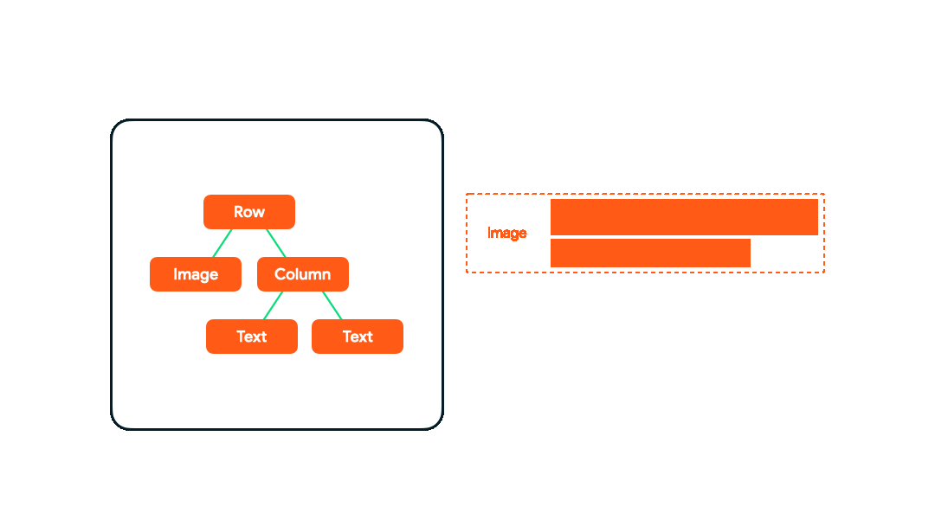
Compose phases
Composition
Layout
Drawing
Souce code
Layout node tree
Layout resut
Displayed UI

Slide 6
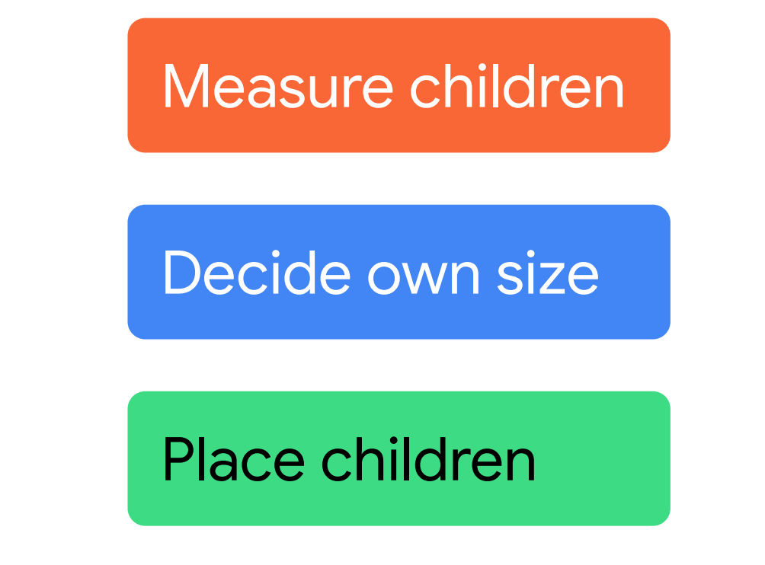
Layout phases

Slide 7
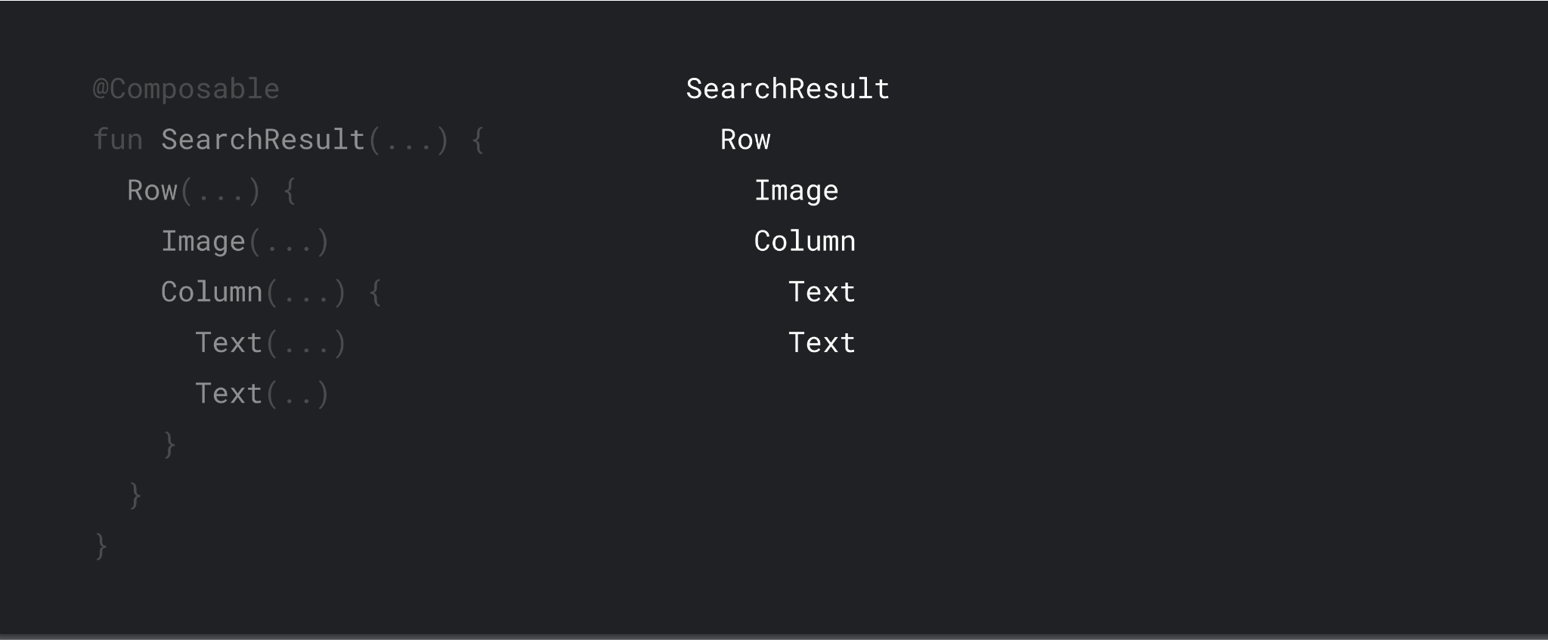

Slide 8
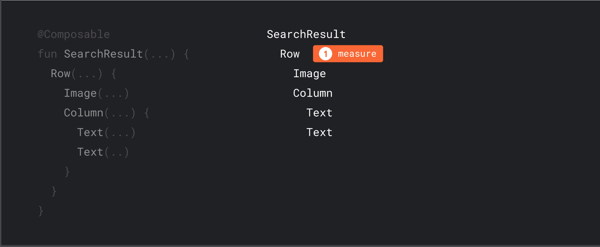

Slide 9
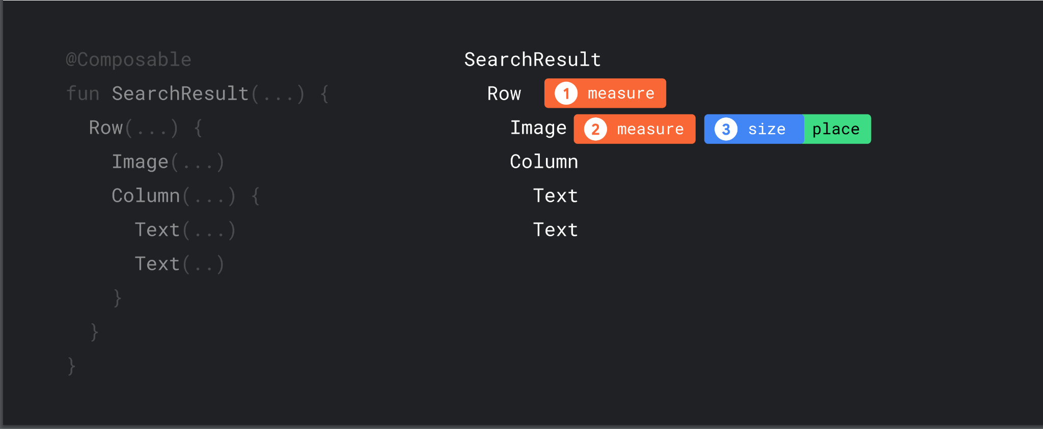

Slide 10
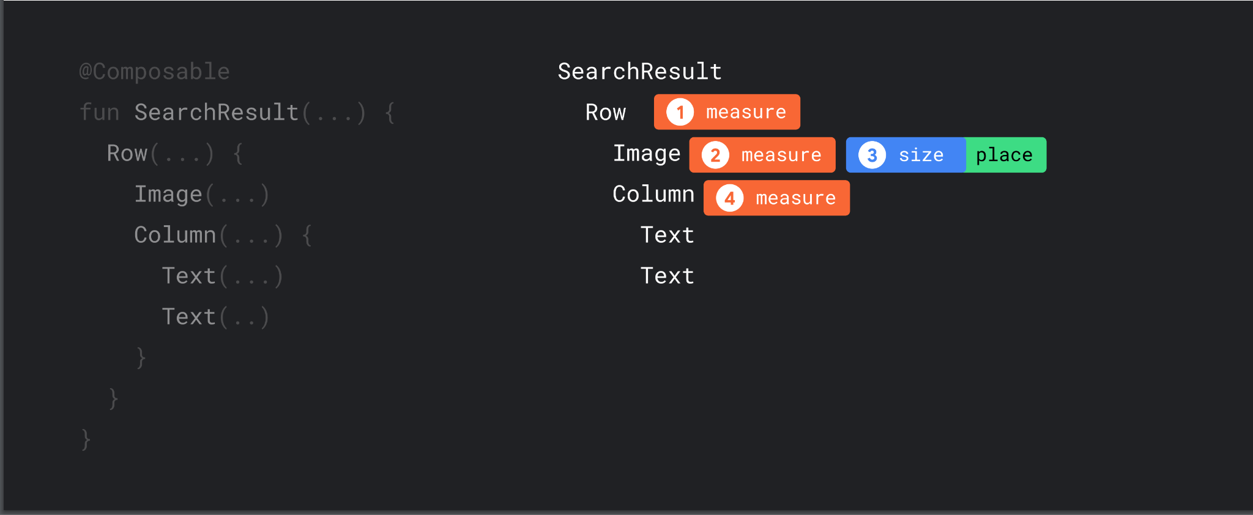

Slide 11
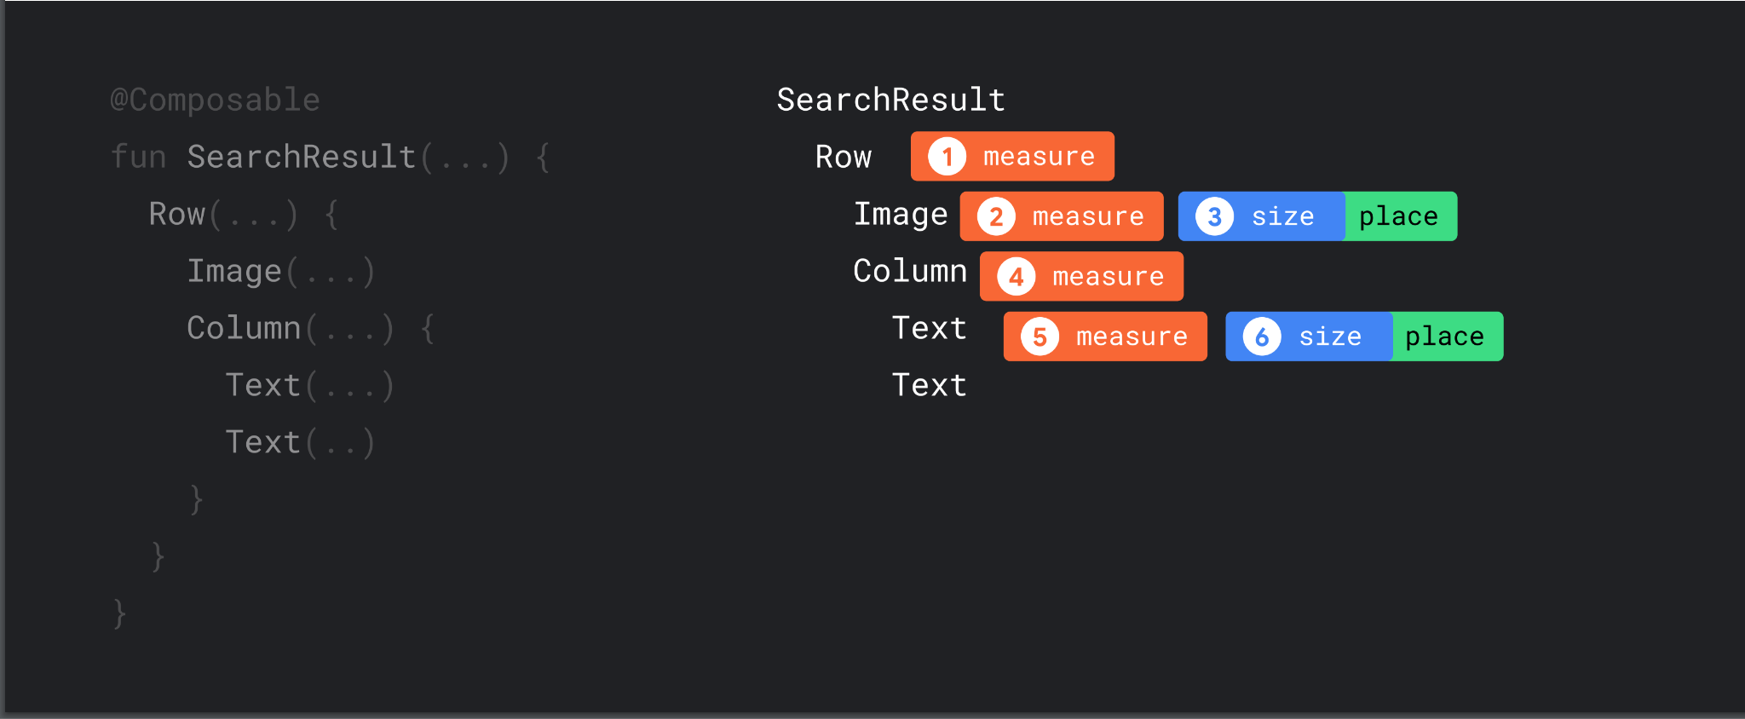

Slide 12
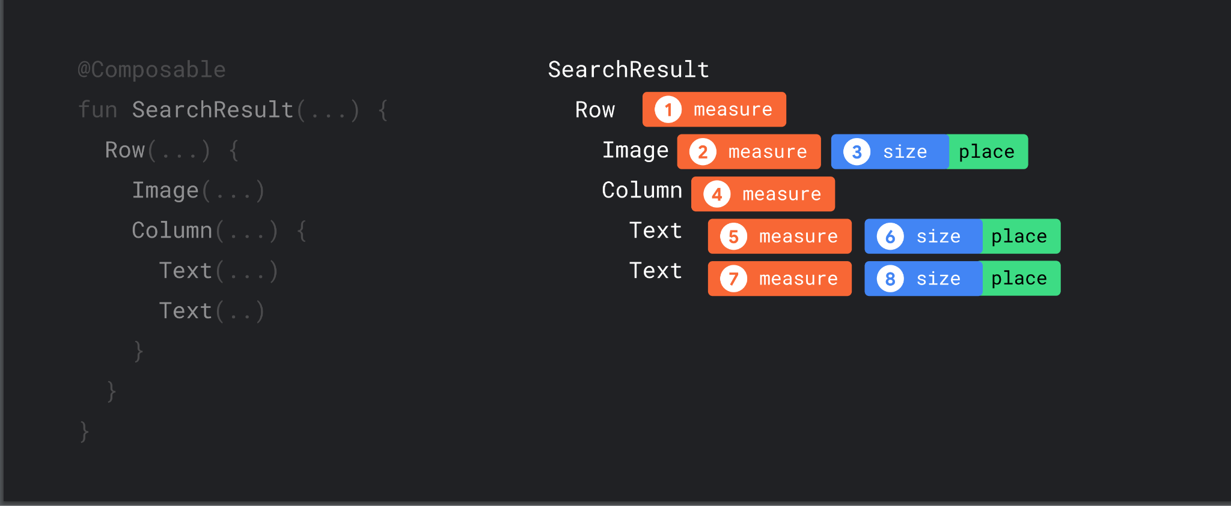

Slide 13
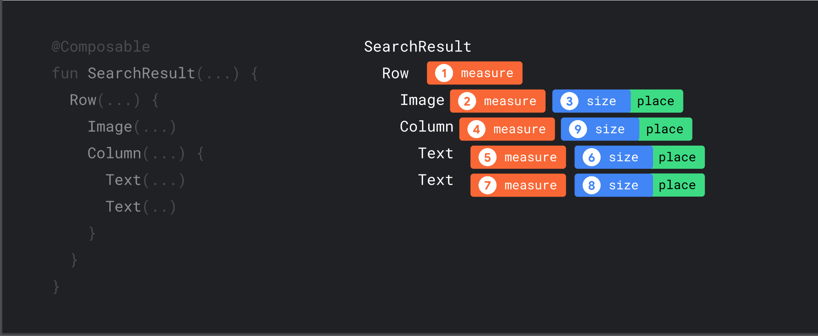

Slide 14
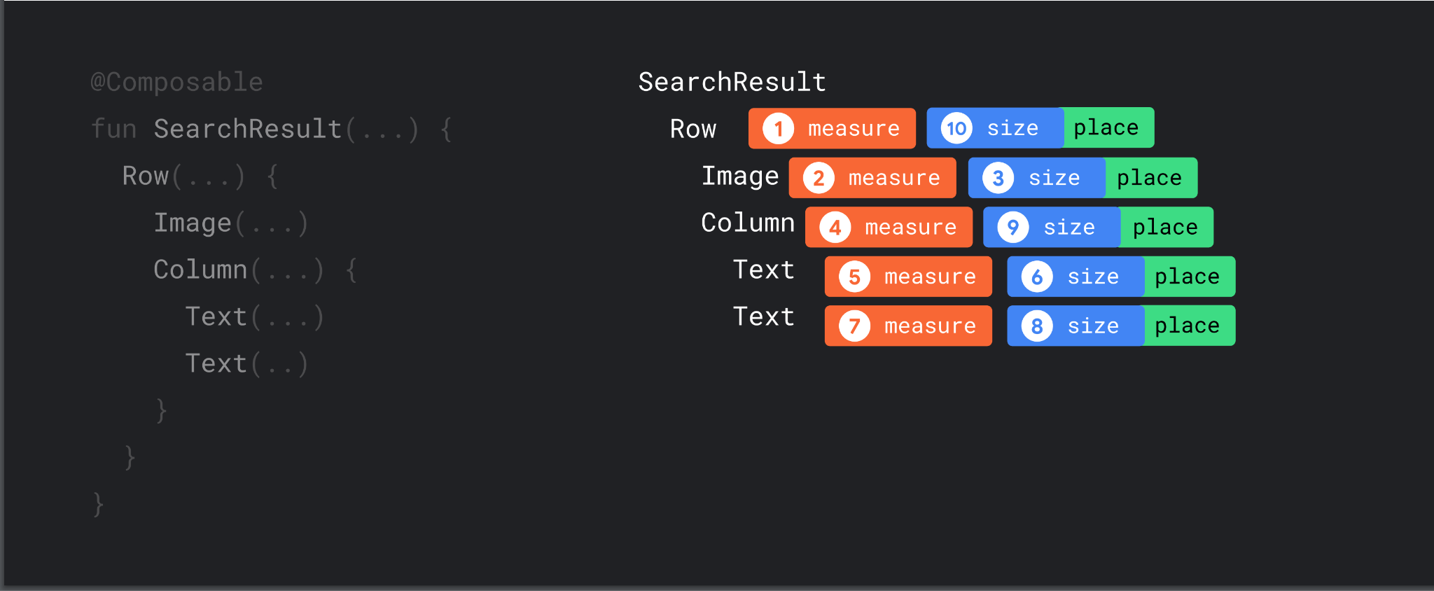

Slide 15
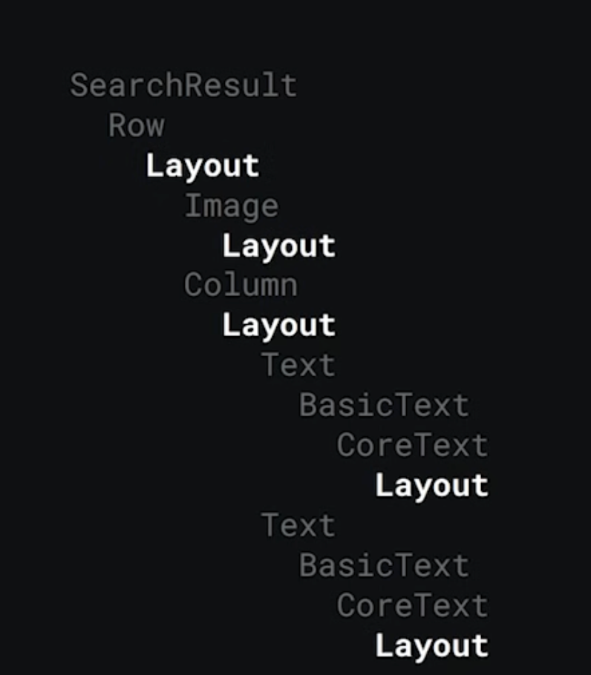
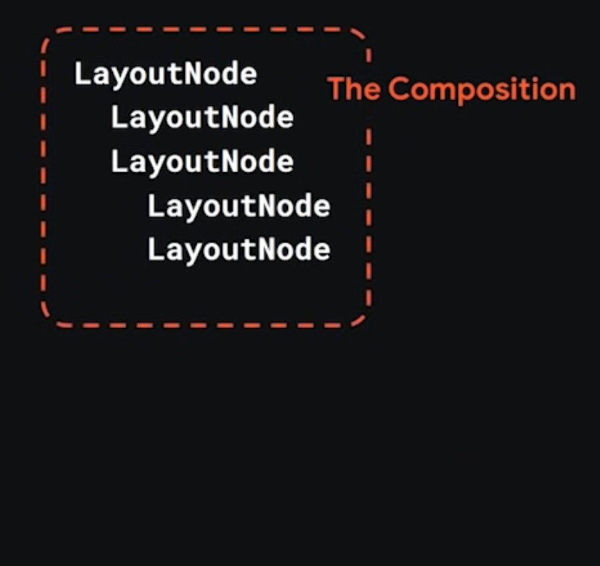
@Composable
fun SearchResult(...) {
Row(...) {
Image(...)
Column(...) {
Text(...)
Text(...)
}
}
}

Slide 16
Layout Composable
@Composable
inline fun Column(
modifier: Modifier = Modifier,
verticalArrangement: Arrangement.Vertical = Arrangement.Top,
horizontalAlignment: Alignment.Horizontal = Alignment.Start,
content: @Composable ColumnScope.() -> Unit
) {
val measurePolicy = columnMeasurePolicy(verticalArrangement, horizontalAlignment)
Layout(
content = { ColumnScopeInstance.content() },
measurePolicy = measurePolicy,
modifier = modifier
)
}

Slide 17
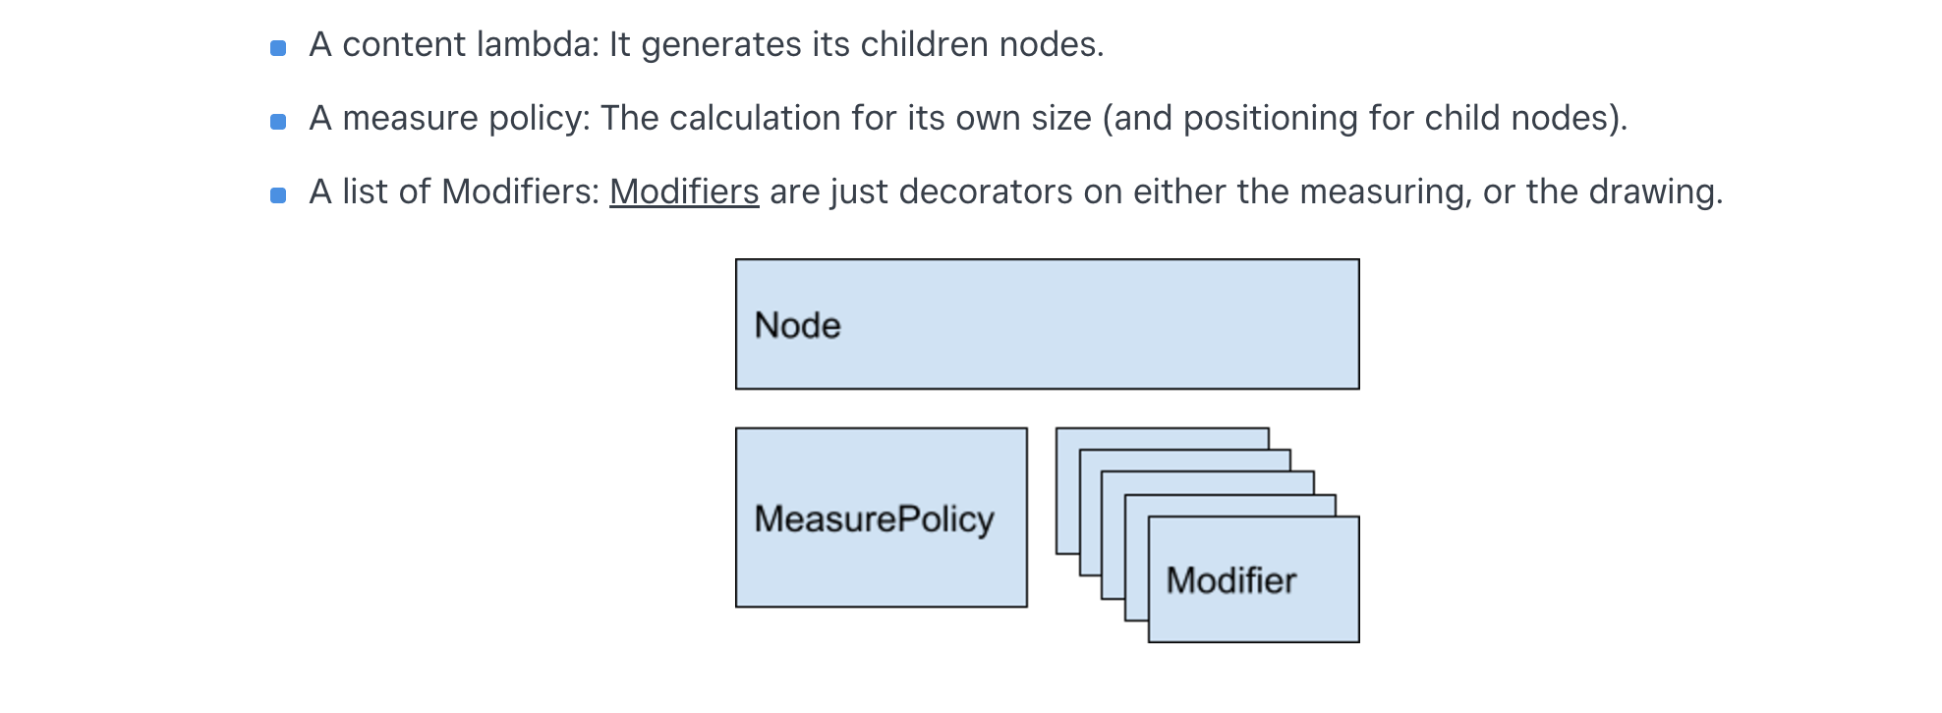

Layout Composable

Slide 18
Measure Policy
fun interface MeasurePolicy {
fun MeasureScope.measure(
measurables: List<Measurable>,
constraints: Constraints
): MeasureResult
}
class Constraints {
val minWidth: Int
val maxWidth: Int
val minHeight: Int
val maxHeight: Int
...
}

Slide 19
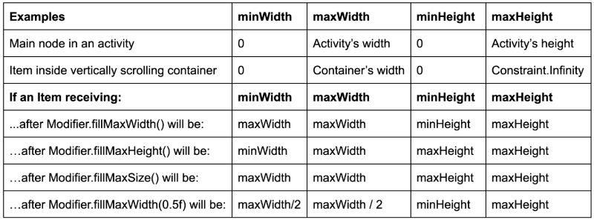
Constraints

Slide 20
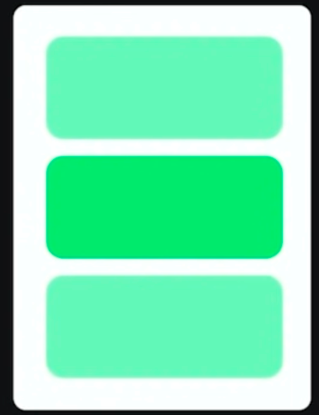
MyColumn Example
MyColumn(...) {
Text(...)
Text(...)
Text(...)
}

Slide 21
@Composable
fun MyColumn(
modifier: Modifier = Modifier,
content: @Composable () -> Unit
) {
Layout(
modifier = modifier,
content = content,
measurePolicy = { //this: MeasureScope
measurables, constraints ->
// 1. Measure children
...
// 2. Decide own size
layout(..., ...) { //this: Placeable.PlacementScope
// 3. Place children
...
}// return a MeasureResult
}
)
}

Slide 22
measurePolicy = {
val placeables = measurables.map { measurable ->
// Measure each children
measurable.measure(constraints)
}
val height = placeables.sumOf { it.height }
val width = placeables.maxOf { it.width }
// Set the size of the layout as big as it can
layout(width, height) {
// Track the y co-ord we have placed children up to
var yPosition = 0
// Place children in the parent layout
placeables.forEach { placeable ->
// Position item on the screen
placeable.placeRelative(x = 0, y = yPosition)
// Record the y co-ord placed up to
yPosition += placeable.height
}
}
}

Slide 23
measurePolicy = {
val placeables = measurables.map { measurable ->
// Measure each children
measurable.measure(constraints)
}
val height = placeables.sumOf { it.height }
val width = placeables.maxOf { it.width }
// Set the size of the layout as big as it can
layout(width, height) {
// Track the y co-ord we have placed children up to
var yPosition = 0
// Place children in the parent layout
placeables.forEach { placeable ->
// Position item on the screen
placeable.placeRelative(x = 0, y = yPosition)
// Record the y co-ord placed up to
yPosition += placeable.height
}
}
}

Slide 24
measurePolicy = {
val placeables = measurables.map { measurable ->
// Measure each children
measurable.measure(constraints)
}
val height = placeables.sumOf { it.height }
val width = placeables.maxOf { it.width }
// Set the size of the layout as big as it can
layout(width, height) {
// Track the y co-ord we have placed children up to
var yPosition = 0
// Place children in the parent layout
placeables.forEach { placeable ->
// Position item on the screen
placeable.placeRelative(x = 0, y = yPosition)
// Record the y co-ord placed up to
yPosition += placeable.height
}
}
}

Slide 25
measurePolicy = {
val placeables = measurables.map { measurable ->
// Measure each children
measurable.measure(constraints)
}
val height = placeables.sumOf { it.height }
val width = placeables.maxOf { it.width }
// Set the size of the layout as big as it can
layout(width, height) {
// Track the y co-ord we have placed children up to
var yPosition = 0
// Place children in the parent layout
placeables.forEach { placeable ->
// Position item on the screen
placeable.placeRelative(x = 0, y = yPosition)
// Record the y co-ord placed up to
yPosition += placeable.height
}
}
}

Slide 26
Modifiers
Row(...) {
Image(
...
Modifier
.clip(CircleShape)
.size(40.dp))
Column(
Modifier.padding(start = 8.dp)
) {
Text(
...
Modifier.padding(top = 4.dp)
)
Text(...)
}
}

Slide 27
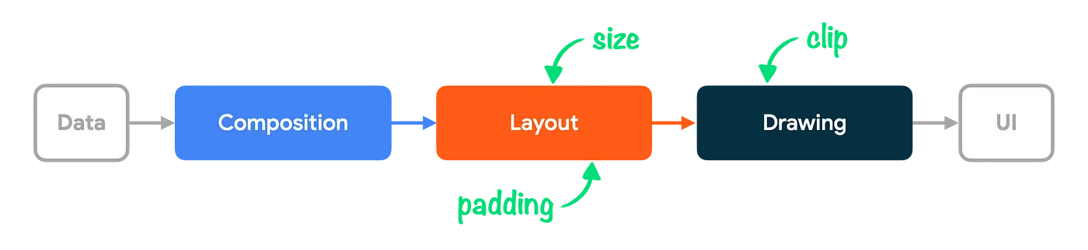
Layout Function
Modifiers

Slide 28
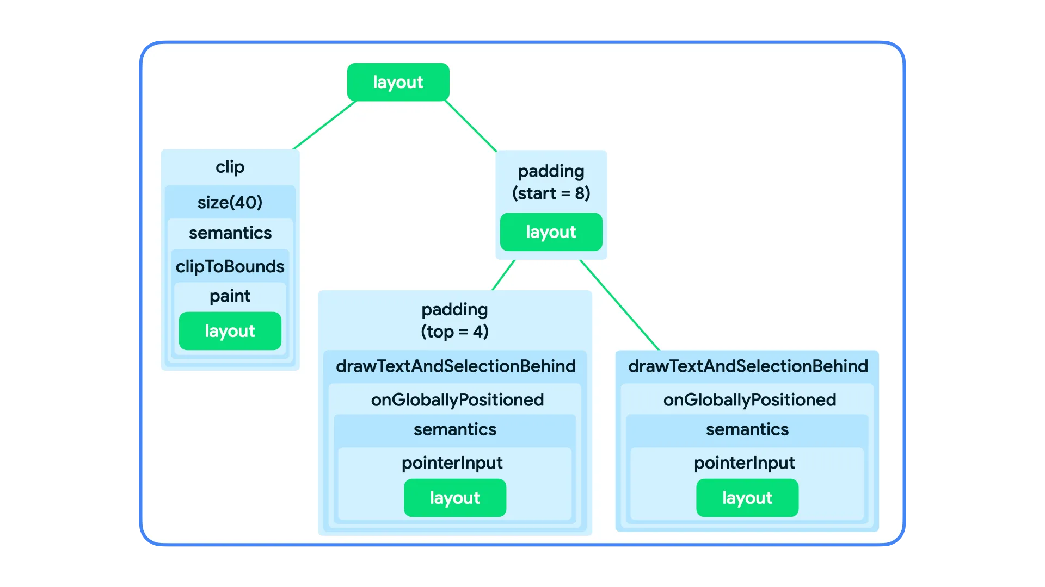
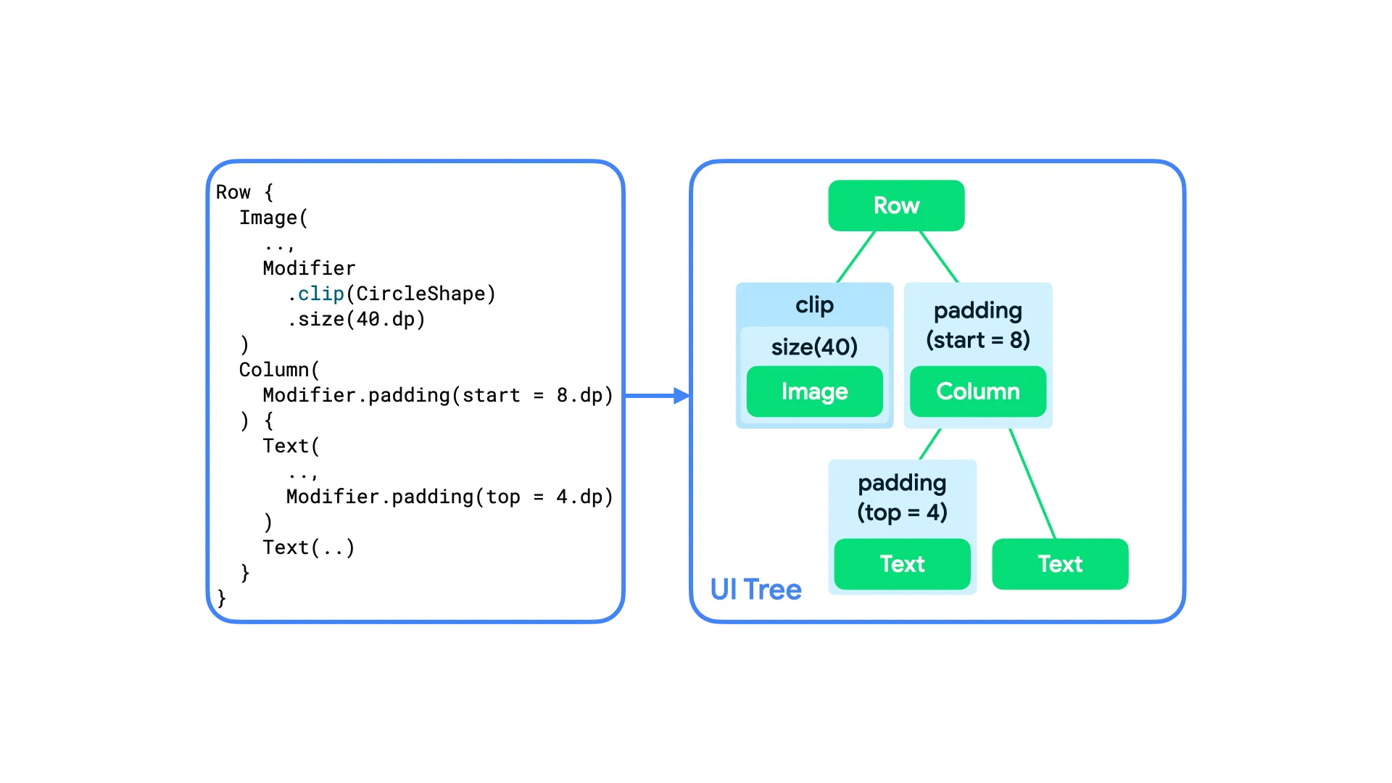
Modifiers
Image and Text composables themselves consist of a chain of modifiers wrapping a single layout node

Slide 29
fun Modifier.padding(
start: Dp = 0.dp,
top: Dp = 0.dp,
end: Dp = 0.dp,
bottom: Dp = 0.dp
) = this then PaddingElement(
start = start,
top = top,
end = end,
bottom = bottom
)
private class PaddingElement(
...
) : ModifierNodeElement<PaddingNode>() {
fun padding
add to chain when composition
PaddingElement
create or update node when composition
PaddingNode

Slide 30
fun Modifier.padding(
start: Dp = 0.dp,
top: Dp = 0.dp,
end: Dp = 0.dp,
bottom: Dp = 0.dp
) = this then PaddingElement(
start = start,
top = top,
end = end,
bottom = bottom
)
private class PaddingElement(
...
) : ModifierNodeElement<PaddingNode>() {
fun padding
add to chain when composition
PaddingElement
create or update node when composition
PaddingNode
A ModifierNodeElement is an immutable class that holds the data to create or update your custom modifier
since 1.5

Slide 31
fun padding
private class PaddingNode(
...
) : LayoutModifierNode, Modifier.Node() {
interface LayoutModifierNode : DelegatableNode {
fun MeasureScope.measure(
measurable: Measurable,
constraints: Constraints
): MeasureResult
}
add to chain when composition
PaddingElement
create or update node when composition
PaddingNode
implement measure
LayoutModifierNode
invoke measure when layout

Slide 32
fun padding
private class PaddingNode(
...
) : LayoutModifierNode, Modifier.Node() {
interface LayoutModifierNode : DelegatableNode {
fun MeasureScope.measure(
measurable: Measurable,
constraints: Constraints
): MeasureResult
}
add to chain when composition
PaddingElement
create or update node when composition
PaddingNode
implement measure
LayoutModifierNode
only one measurable
invoke measure when layout

Slide 33
Modifier.layout { }
fun Modifier.layout(
measure: MeasureScope.(Measurable, Constraints） -> MeasureResult
)
Box(Modifier
.background(Color.Gray)
.layout { measurable, constraints ->
// an example modifier that adds 50 pixels of vertical padding
val padding = 50
val placeable = measurable.measure(constraints.offset(vertical = -padding))
layout(placeable.width, placeable.height + padding) {
placeable.placeRelative(0, padding)
}
}){ ... }

Slide 34
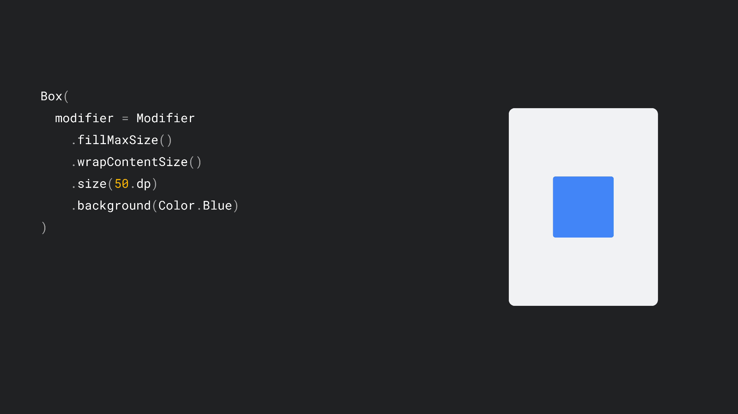

Slide 35
//align = Alignment.Center

Slide 36
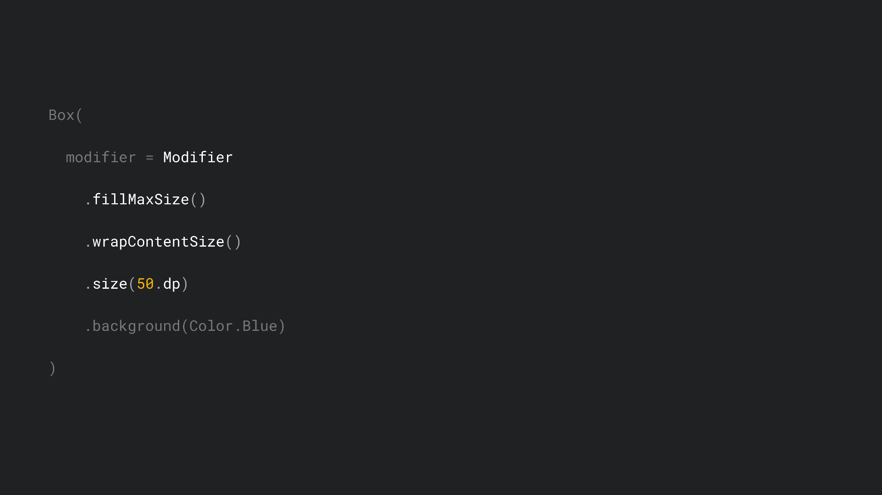

Slide 37
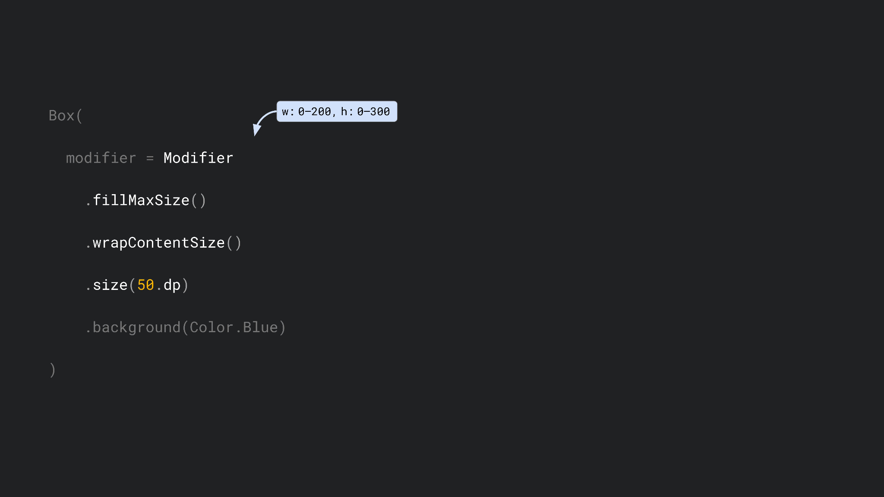

Slide 38
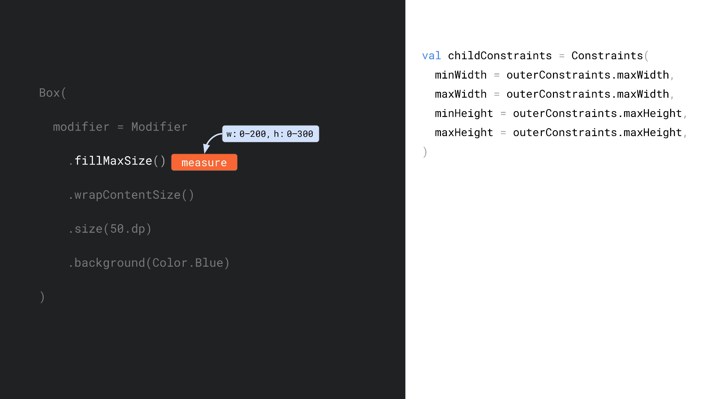

Slide 39
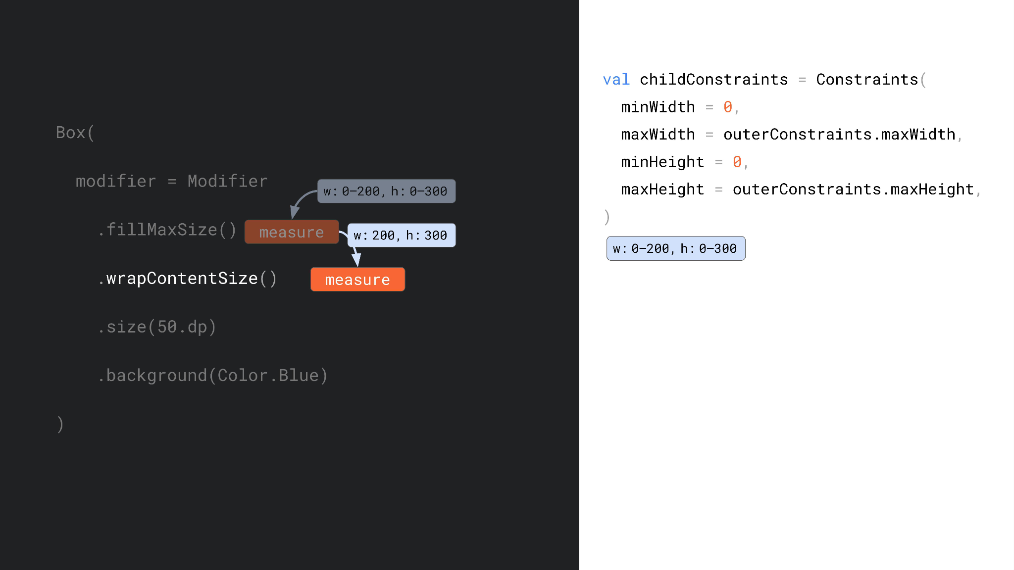

Slide 40
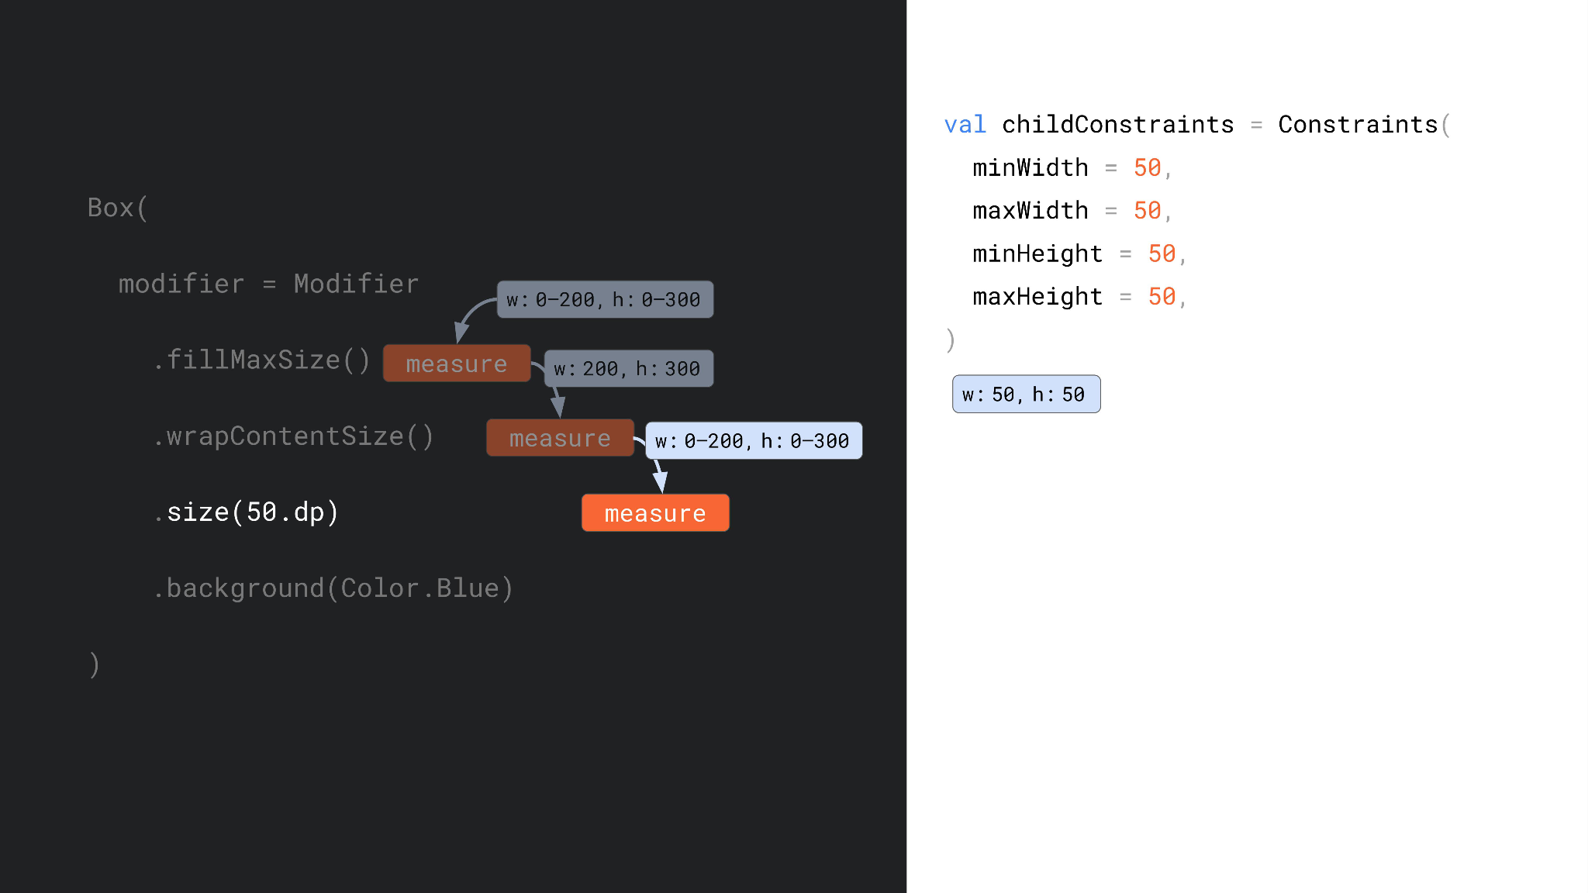

Slide 41
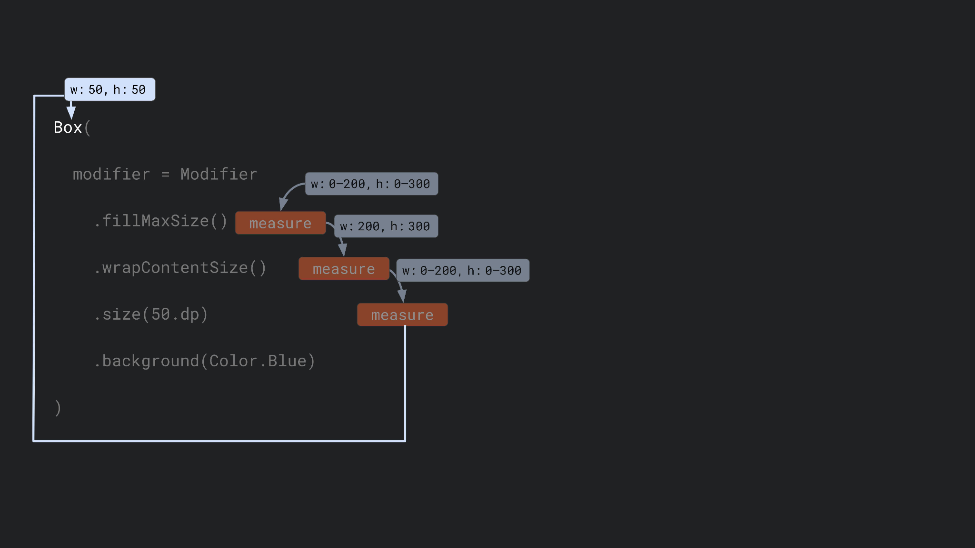

Slide 43
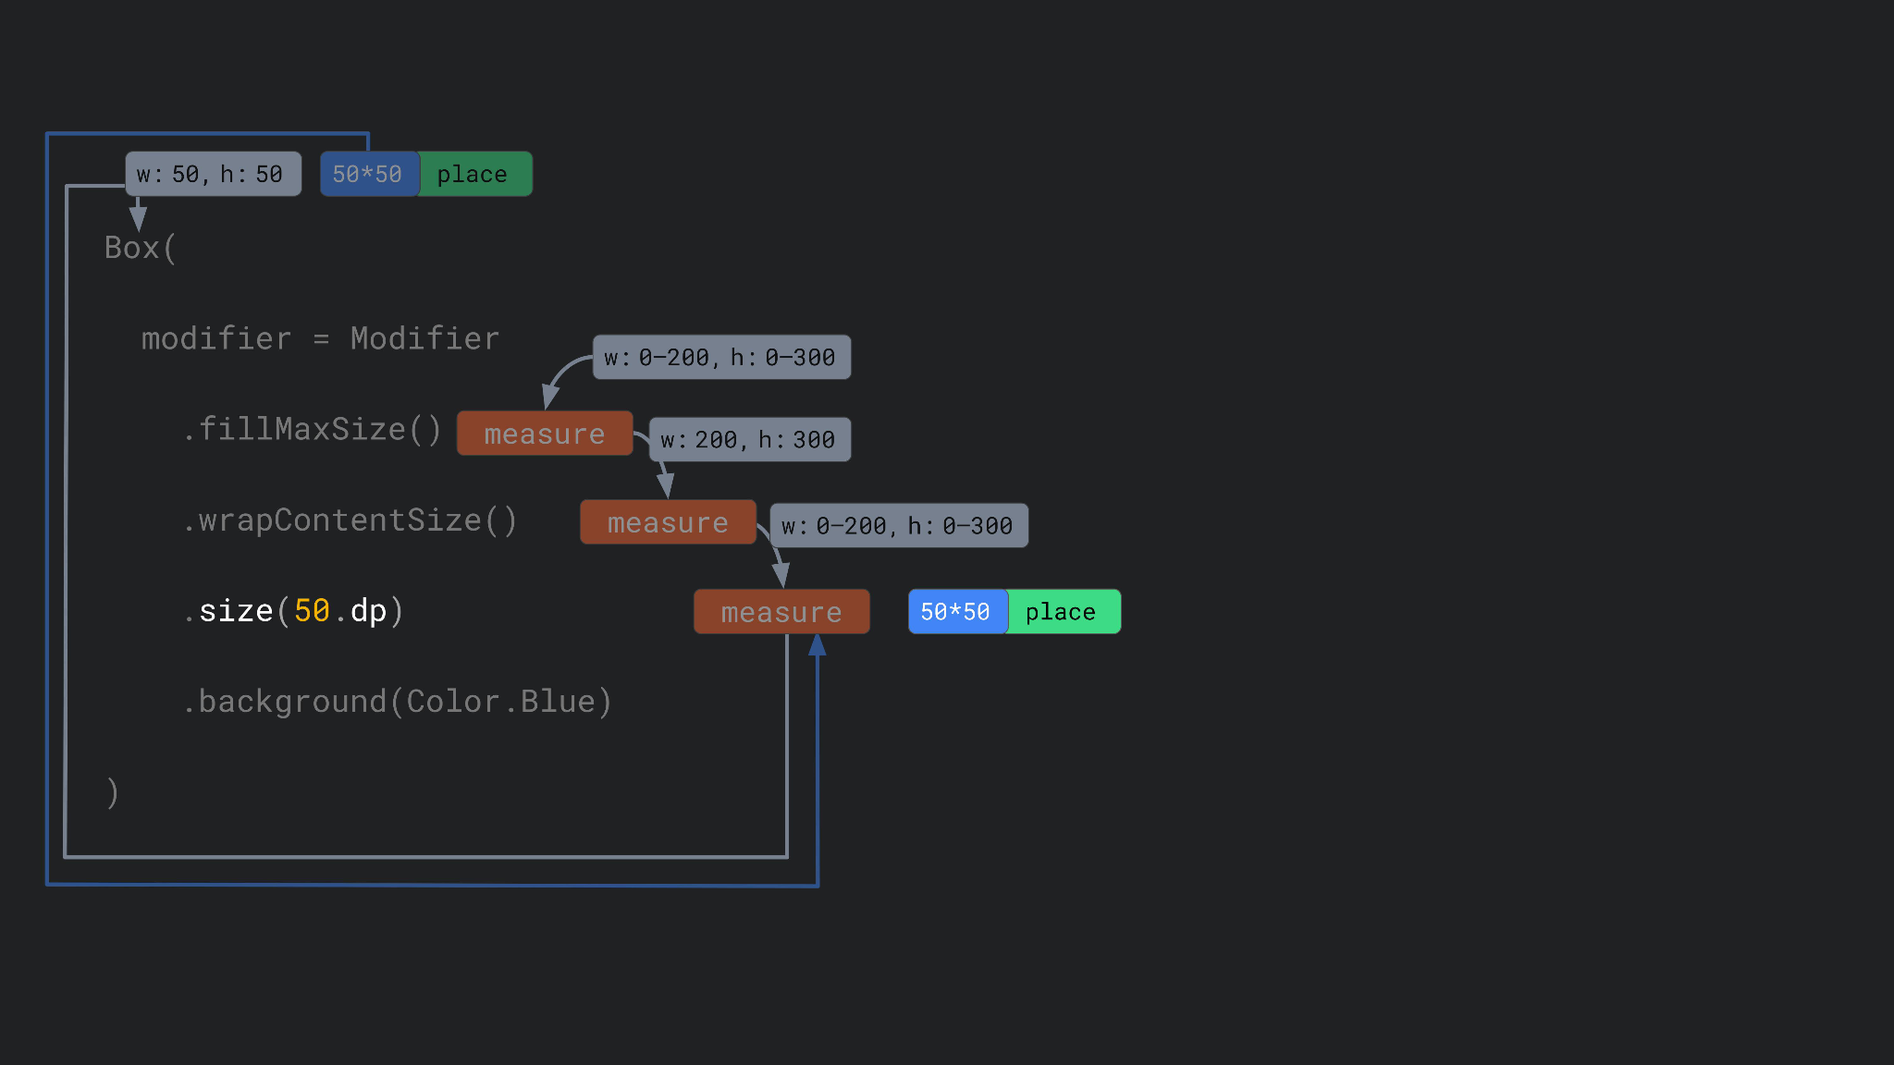

Slide 44
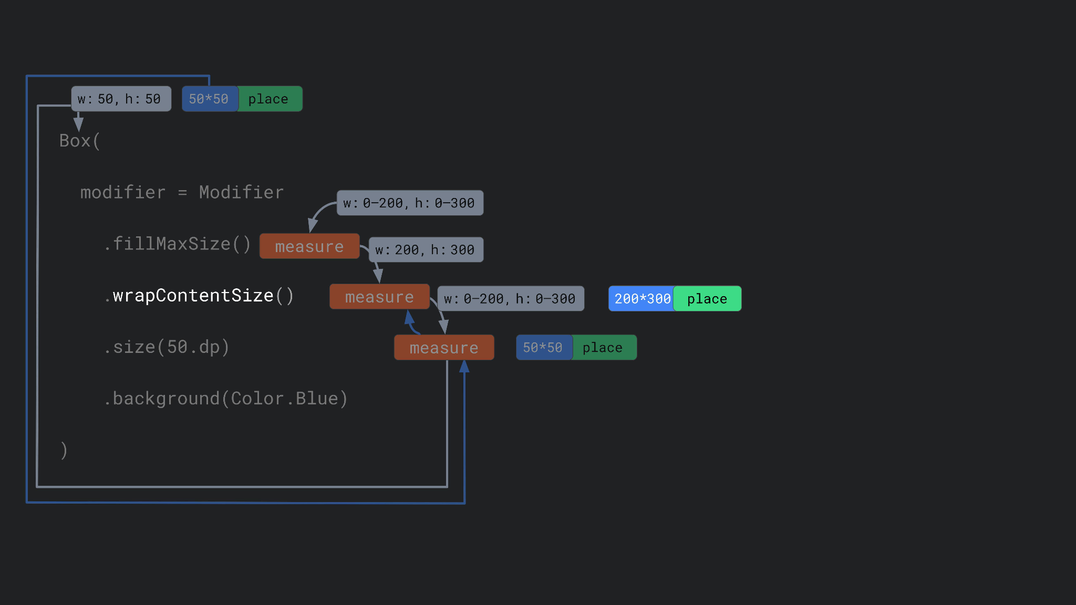

Slide 45
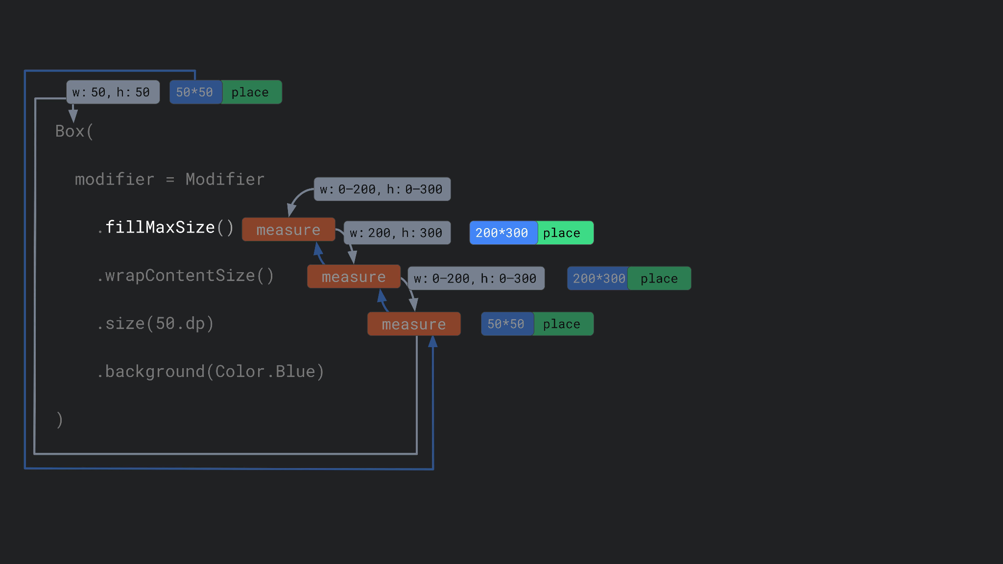

Slide 46
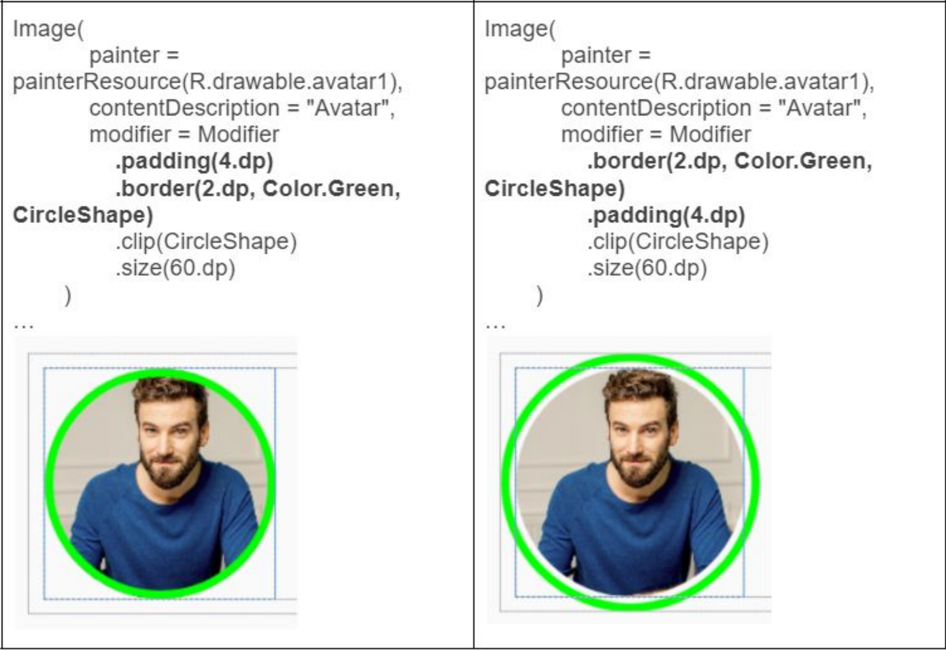
Modifier order

Slide 47
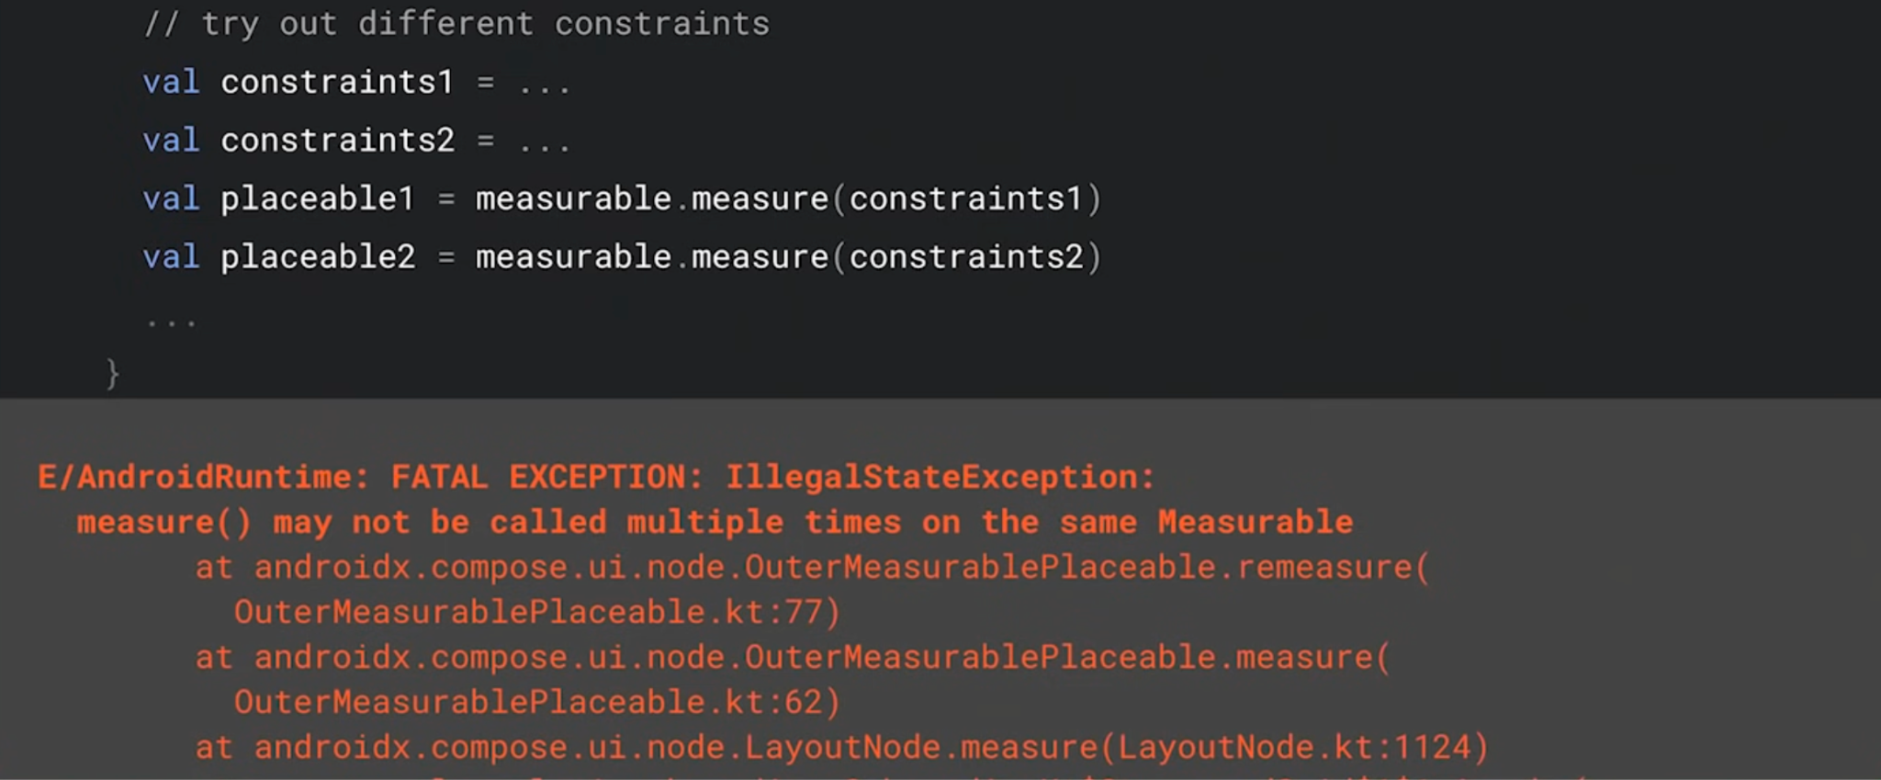

Instrinsic measurements

Slide 48
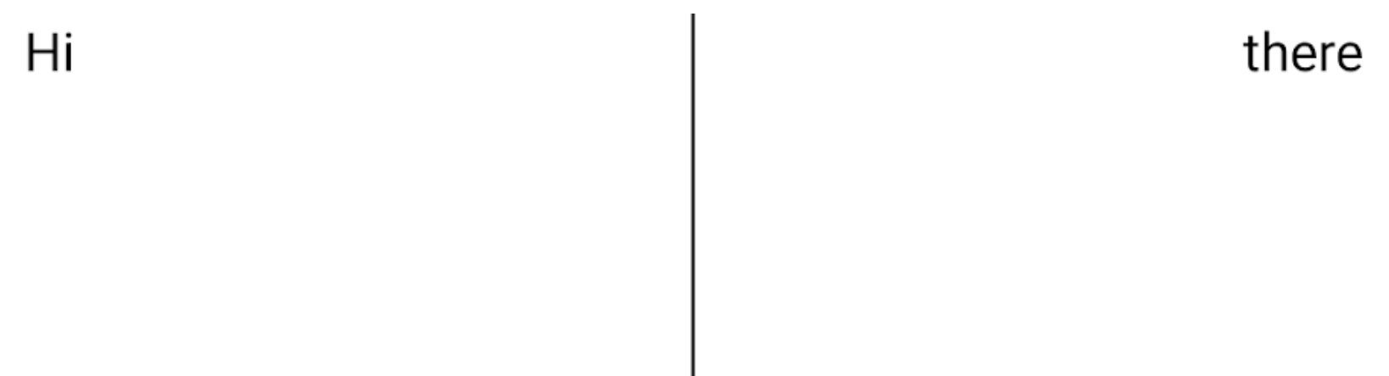
@Composable
fun TwoTexts(modifier: Modifier = Modifier, text1: String, text2: String) {
Row(modifier = modifier) {
Text(
modifier = Modifier
.weight(1f)
.padding(start = 4.dp)
.wrapContentWidth(Alignment.Start),
text = text1
)
Divider(
color = Color.Black,
modifier = Modifier.fillMaxHeight().width(1.dp)
)
Text(
modifier = Modifier
.weight(1f)
.padding(end = 4.dp)
.wrapContentWidth(Alignment.End),
text = text2
)
}
}
expect…
but…

Slide 49
Android Native View
Parent
measure
2 times
Hi
|
there

Slide 50
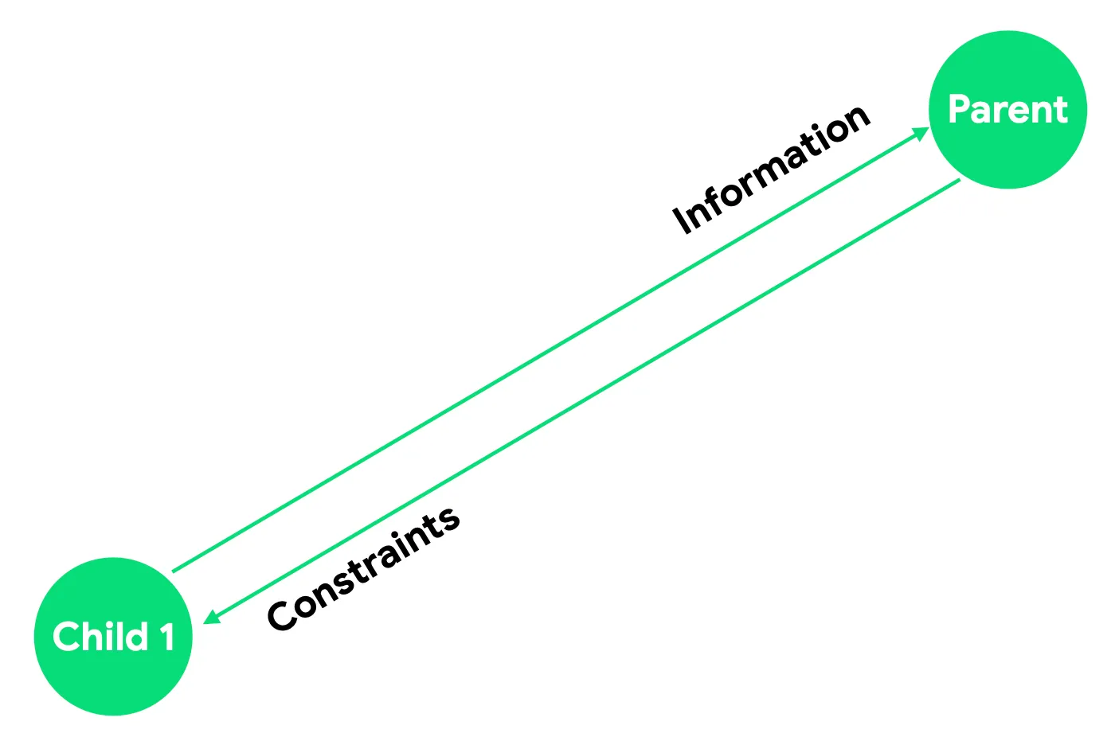
Instrinsic measurements
Sometimes the parent layout needs to know some information about its children before measuring them, so that it could use this information for defining and passing down constraints.
This is what Intrinsic measurements do — they let you query children before they’re measured.

Slide 51
@Composable
fun TwoTexts(modifier: Modifier = Modifier, text1: String, text2: String) {
Row(modifier = modifier.height(IntrinsicSize.Min)) {
Text(
modifier = Modifier
.weight(1f)
.padding(start = 4.dp)
.wrapContentWidth(Alignment.Start),
text = text1
)
Divider(
color = Color.Black,
modifier = Modifier.fillMaxHeight().width(1.dp)
)
Text(
modifier = Modifier
.weight(1f)
.padding(end = 4.dp)
.wrapContentWidth(Alignment.End),
text = text2
)
}
}

Slide 52
Custom Instrinsic measurements
fun interface MeasurePolicy {
fun MeasureScope.measure(...): MeasureResult
...
fun IntrinsicMeasureScope.minIntrinsicWidth(
measurables: List<IntrinsicMeasurable>,
height: Int
): Int
fun IntrinsicMeasureScope.minIntrinsicHeight
fun IntrinsicMeasureScope.maxIntrinsicWidth
fun IntrinsicMeasureScope.maxIntrinsicHeight
}

Slide 53
Custom Instrinsic measurements
Layout(
modifier = modifier,
content = content,
measurePolicy = object : MeasurePolicy {
override fun IntrinsicMeasureScope.maxIntrinsicHeight(
measurables: List<IntrinsicMeasurable>,
width: Int
): Int {
// Logic for calculating custom maxIntrinsicHeight here
}
// Other intrinsics related methods have a default value,
// you can override only the methods that you need.
}
)

Slide 54
Beijing
Thank You!
王鹏（Android GDE）
12/07/2024

